Slide 1
Project Management Tool
Aman Kumar , Sandeep Behera , Yogesh Sahu , Deepa Bharti

Slide 2
Technologies Used
Java 8
Spring Boot
Spring Security
React And Redux
Maven
MySQL
Postman

Slide 3
Problem Statement
In PTM tool we are providing a platform for managing the projects, when management of the project is concerned, we mean below things.
User was able to click on dashboard
Get all the list of Projects created on Dashboard
Clicking on createProjectButton was allowing you to create new project entry
Inside project we can add different tasks and track the status of the task.
By selecting the priority option we can set priority of the task
Update link was used to update the project details
Delete link was used to delete the project entry
When user click on Projectborad button on project card, the below project Task should be displayed
Project Task is categorized in 4 categories i.e To-Do ,In-Progress , Done, Backlog

Slide 4
Plan
1. Design
Generate the skeleton as per class design provided
2. TDD Approach
Identify the test cases for each Module
Write failing Test Cases
Convert the Test cases in Green
3. Implement the case study In Incremental way

Slide 5
Modules
Sign up/Sign In Module
Dashboard
Add /Update/Delete Project
Add /Delete/Update Project Task(Inside dashboard )
1.To-Do 2.In-progress
3.Done 4.Backlog
Logout

Slide 6
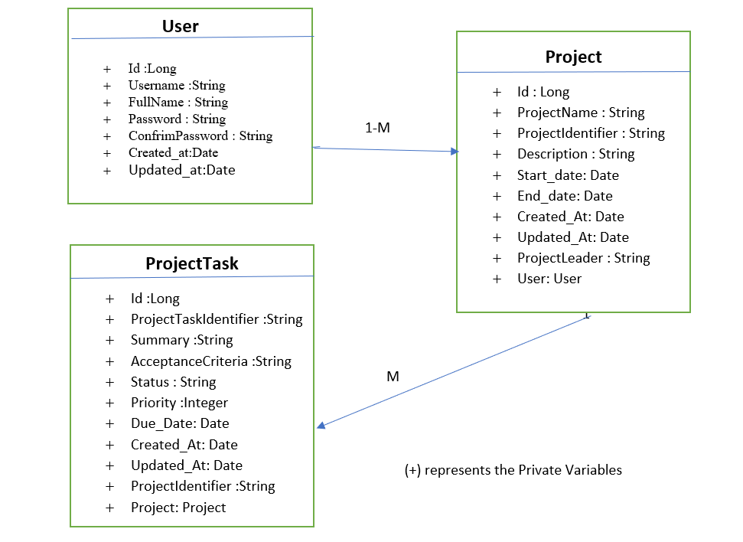
Class Design (POJO Classes)

Slide 7
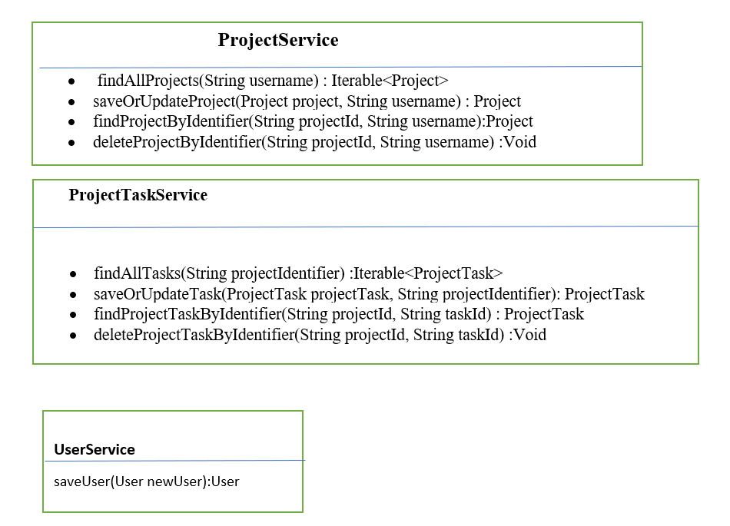
Class Design(Service Classes)

Slide 8
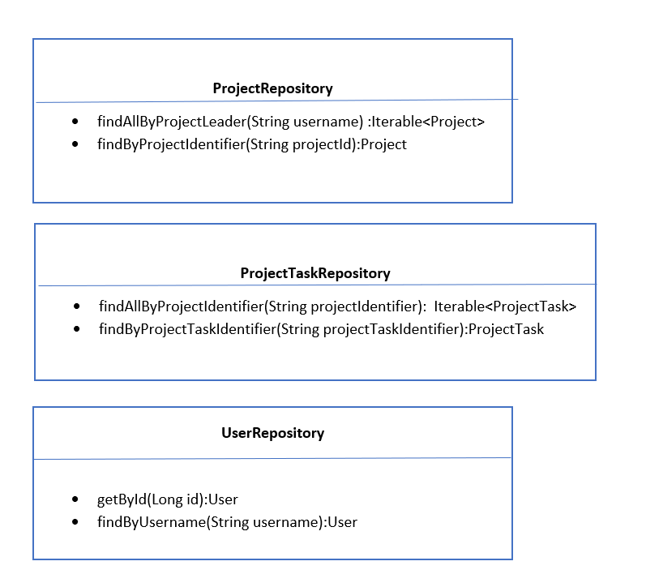
Class Design(Repository Interfaces)

Slide 9
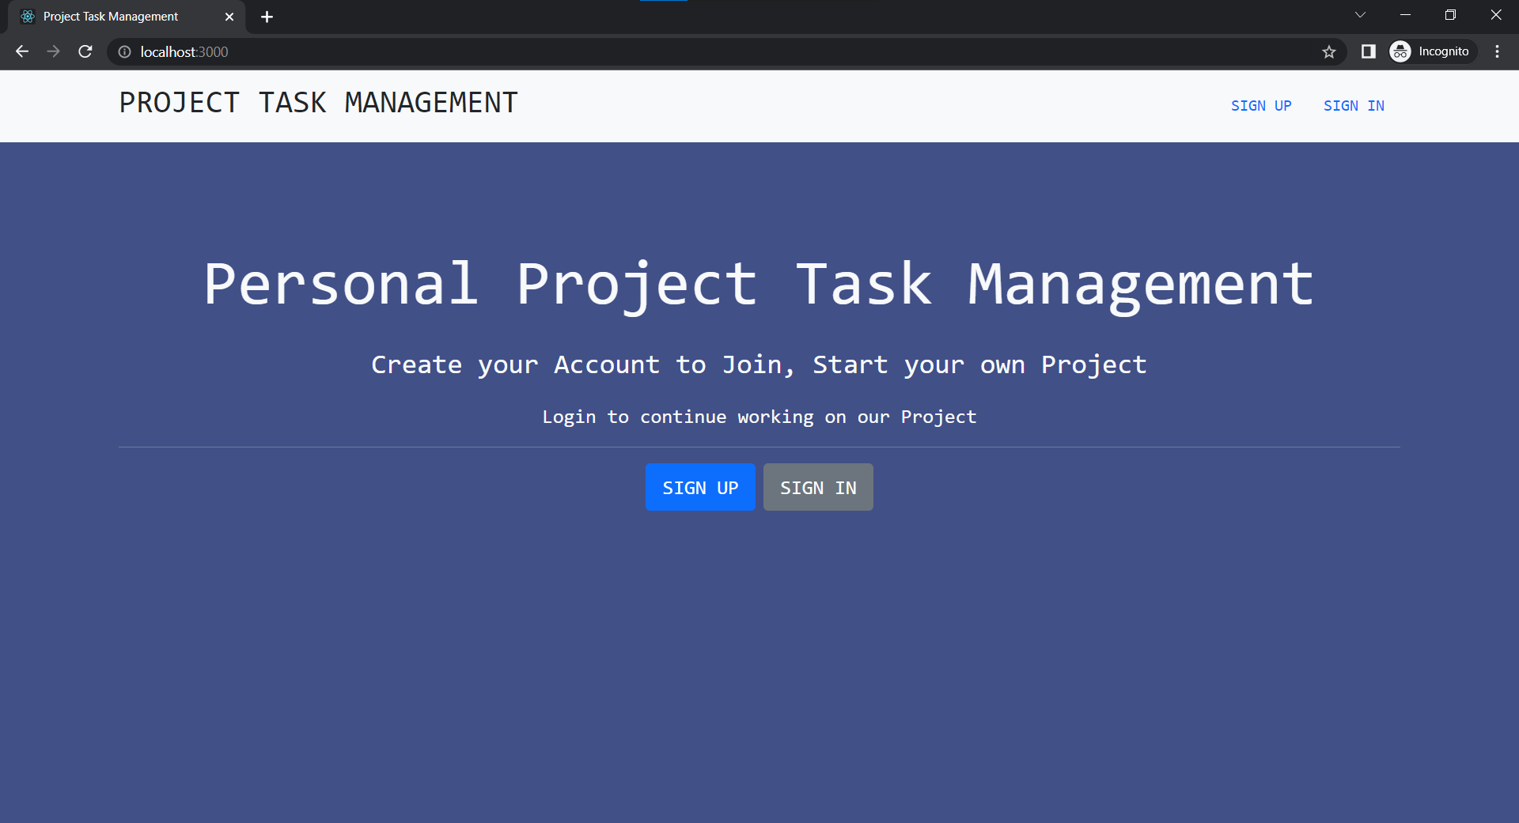
Output Images

Slide 10
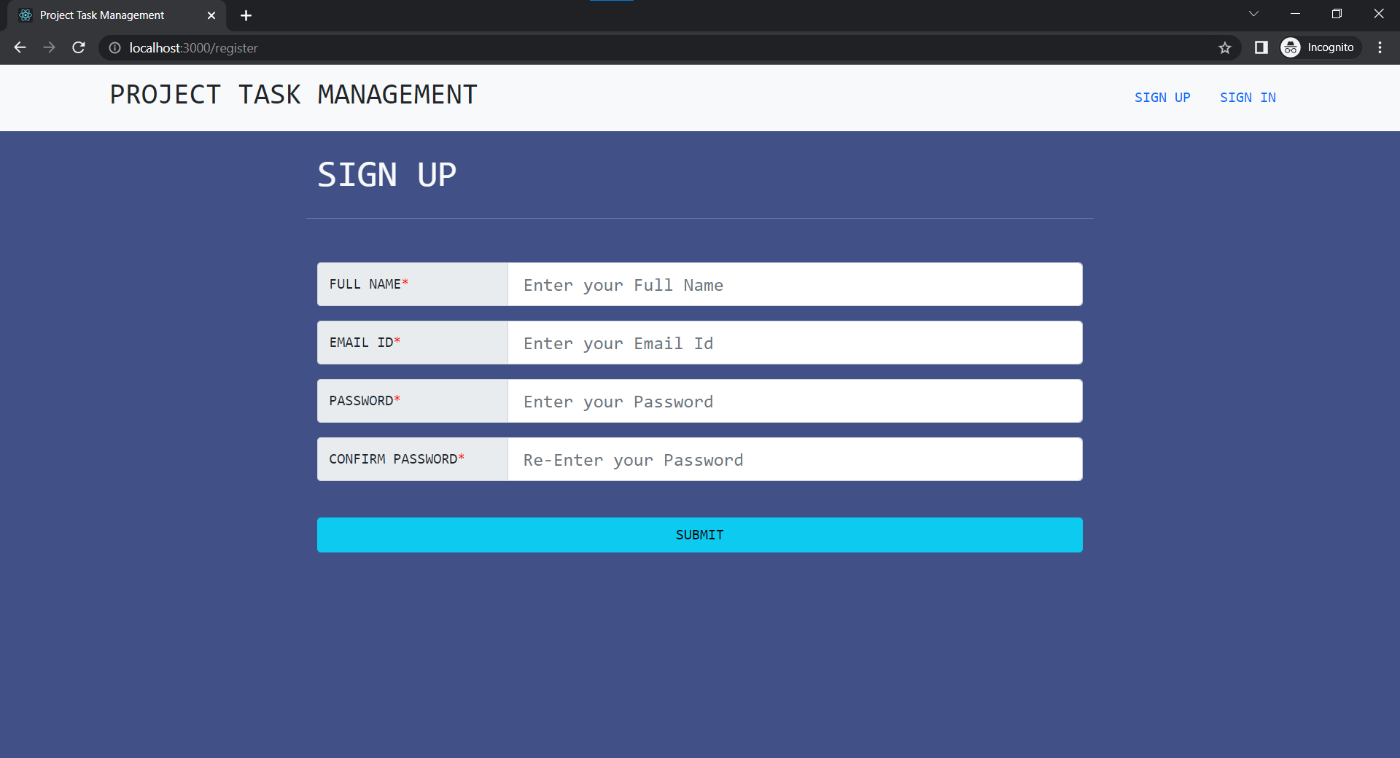
Output Images

Slide 11
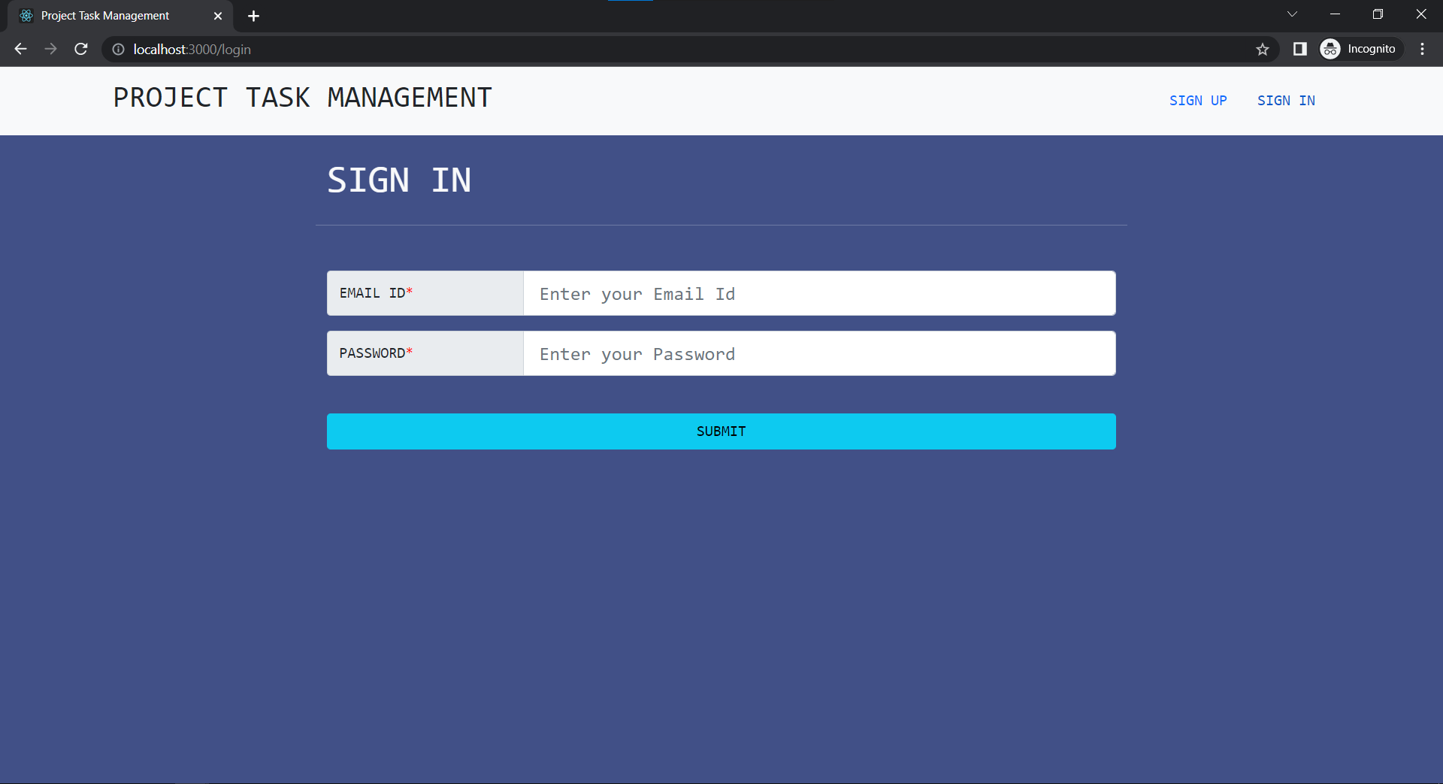

Slide 12
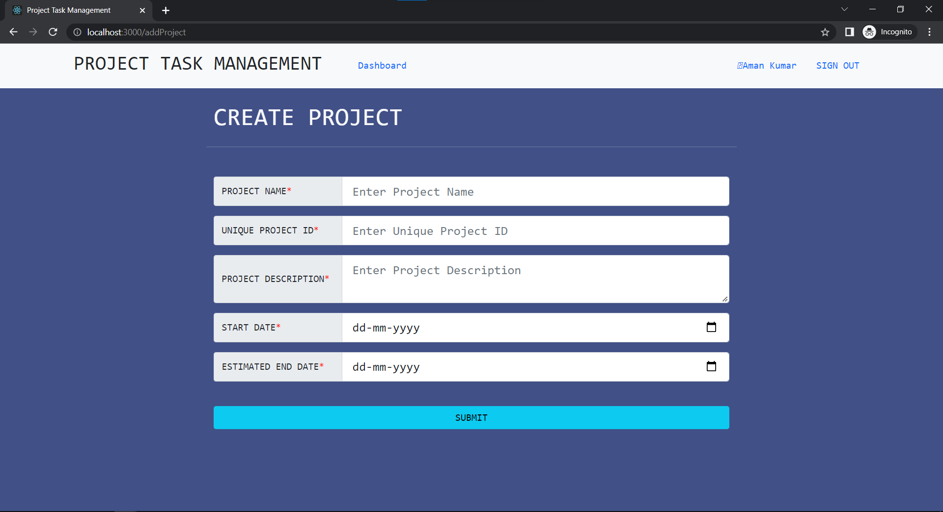

Slide 13
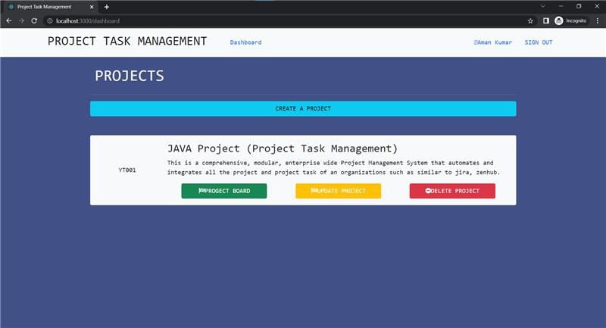

Slide 14
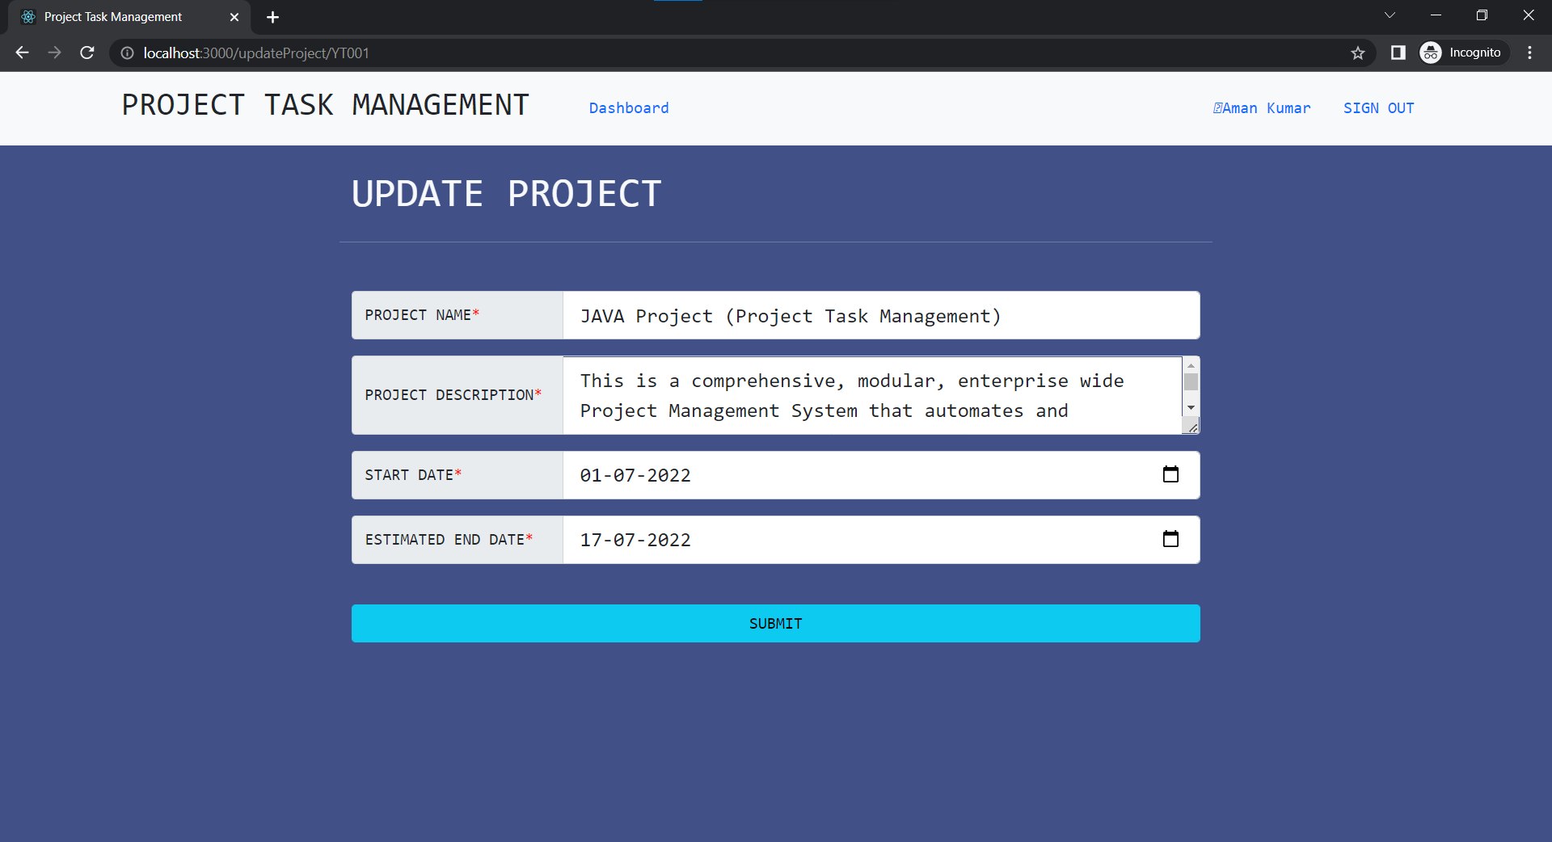

Slide 15
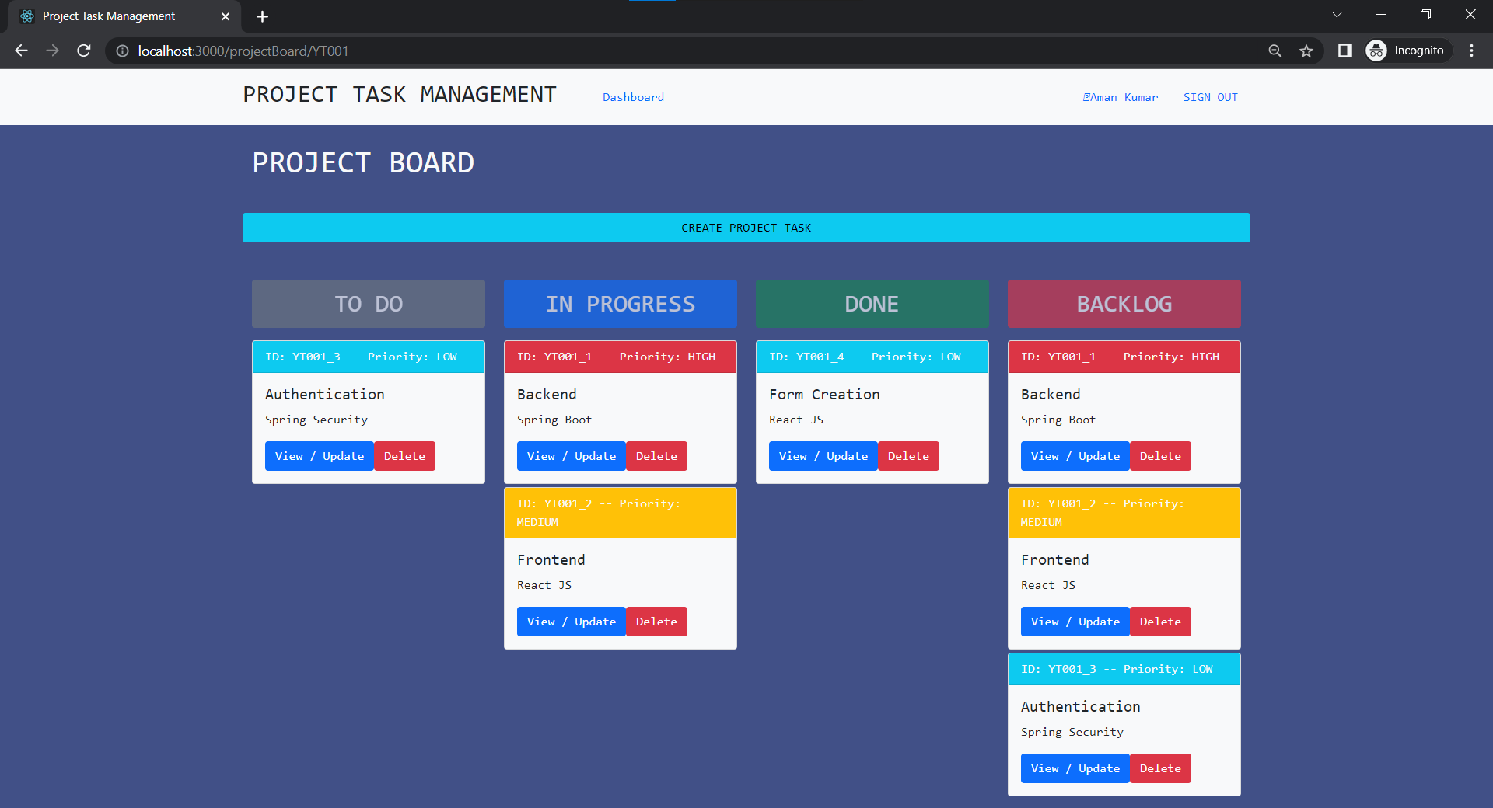

Slide 16
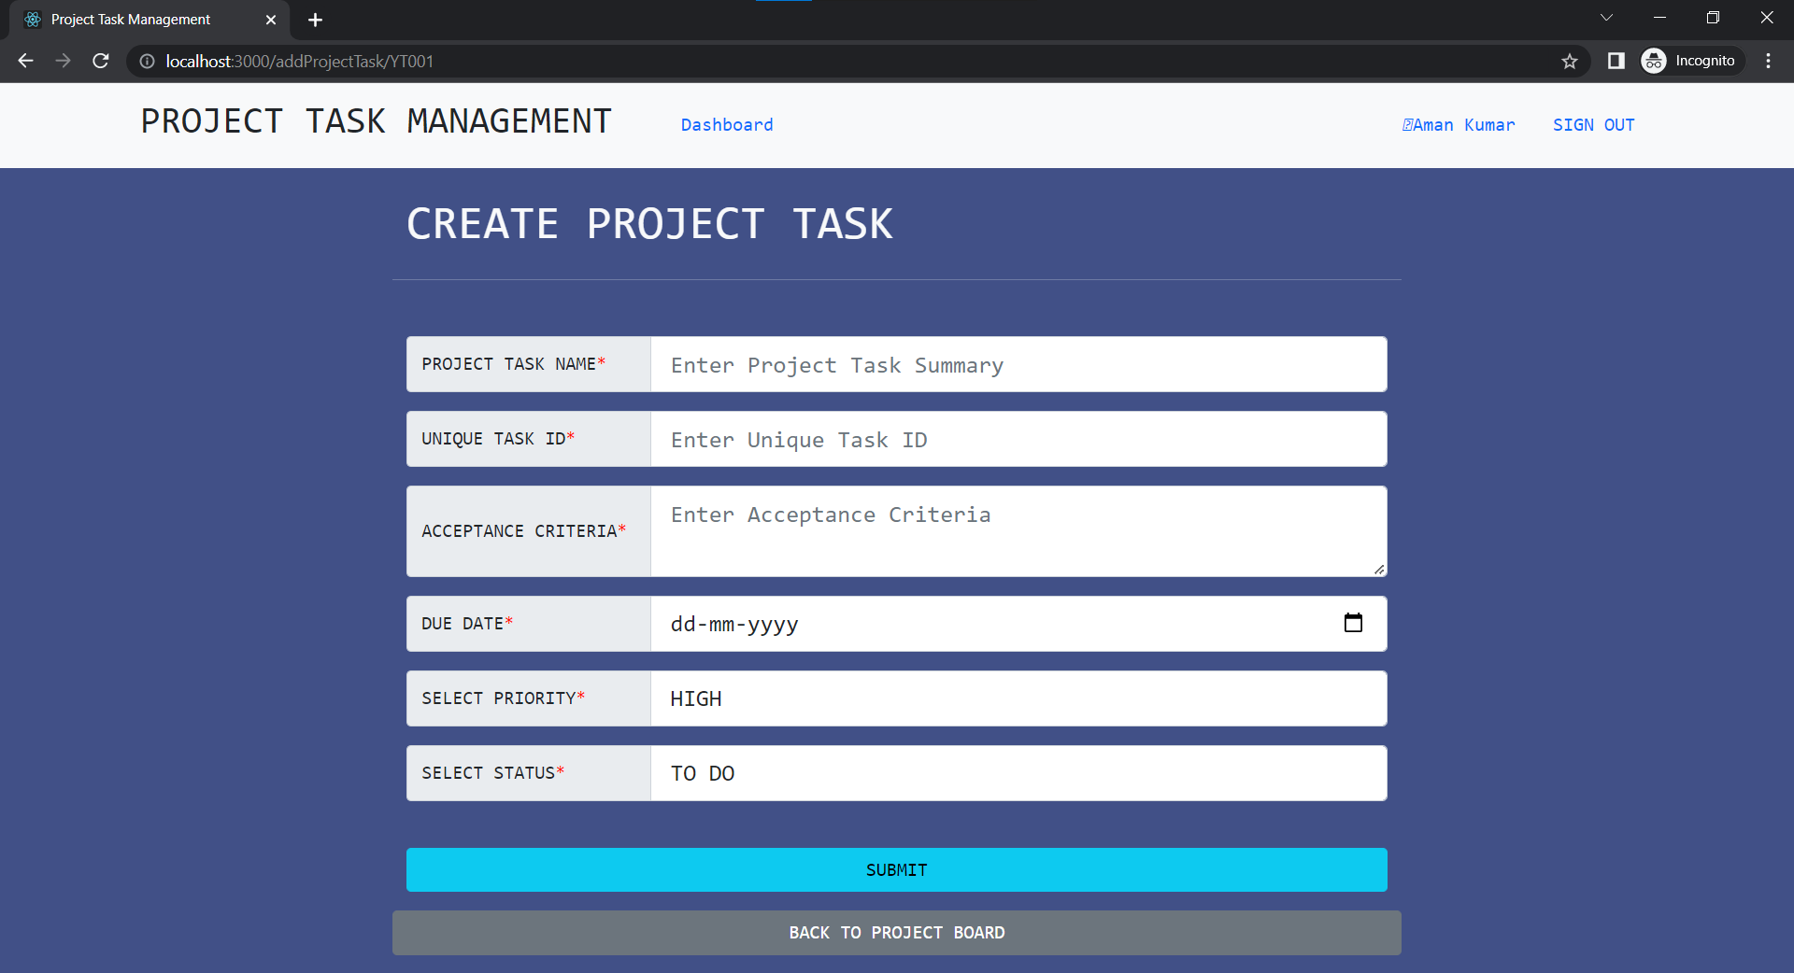

Slide 17
